Slide 1
CNNs variants Evolution
LeNet (1998) – The pioneer of CNNs; introduced the concept of convolution + pooling for handwritten digit recognition.
AlexNet (2012) – Sparked the deep learning revolution; used ReLU, dropout, and GPU training to achieve huge ImageNet success.
VGG (2014) – Showed that depth and uniform small filters (3×3) improve performance, though at the cost of computation.
ResNet (2015) – Solved the vanishing gradient problem using skip connections, allowing networks with 100+ layers to train effectively.

Slide 2
LeNet → AlexNet → VGG → ResNet represents the evolution from shallow to ultra-deep CNNs.
ResNet is the foundation for most modern architectures (e.g., EfficientNet, DenseNet, Vision Transformers use similar residual ideas).
VGG remains popular for feature extraction in transfer learning due to its simplicity.
AlexNet introduced GPU acceleration and ReLU — two turning points in deep learning history.

Slide 3
Aspect | LeNet-5 (1998) | AlexNet (2012) | VGGNet (2014) | ResNet (2015)
Introduced by | Yann LeCun et al. | Alex Krizhevsky et al. | Karen Simonyan & Andrew Zisserman | Kaiming He et al.
Dataset Used | MNIST (digits) | ImageNet (1.2M images, 1000 classes) | ImageNet | ImageNet
Input Size | 32×32 grayscale | 227×227 RGB | 224×224 RGB | 224×224 RGB
# of Layers (approx.) | 5–7 | 8 (5 conv + 3 FC) | 16 or 19 | 34, 50, 101, 152, ...
Main Innovation | First successful CNN for digit recognition | Reintroduced deep CNNs with ReLU and GPU training | Deeper but simple architecture with small (3×3) filters | Introduced residual connections to train very deep networks
Activation Function | Sigmoid / tanh | ReLU | ReLU | ReLU
Pooling | Average pooling | Max pooling | Max pooling | Average pooling (at end)
Normalization | None | Local Response Normalization (LRN) | None | Batch Normalization
# Parameters | ~60K | ~60 million | ~138 million | ~25 million (ResNet-50)
Depth Characteristics | Shallow | Moderately deep | Very deep, uniform | Extremely deep with skip connections
Performance (Top-5 Error on ImageNet) | N/A (MNIST task) | ~16% | ~7.3% (VGG-16) | ~3.6% (ResNet-152)
Training Difficulty | Easy | Hard without GPUs | Hard (vanishing gradients) | Easier due to residual learning
Computational Cost | Low | High (for 2012) | Very high | Moderate (for its depth)
Use Cases | Digit recognition | Object classification | Feature extraction, transfer learning | Most modern CNN-based tasks
Architecture Highlights | Conv → Pool → FC | Conv-ReLU-Pool stacks, dropout, GPUs | Repeated 3×3 conv layers, simplicity | Residual blocks (identity shortcuts)

Slide 4
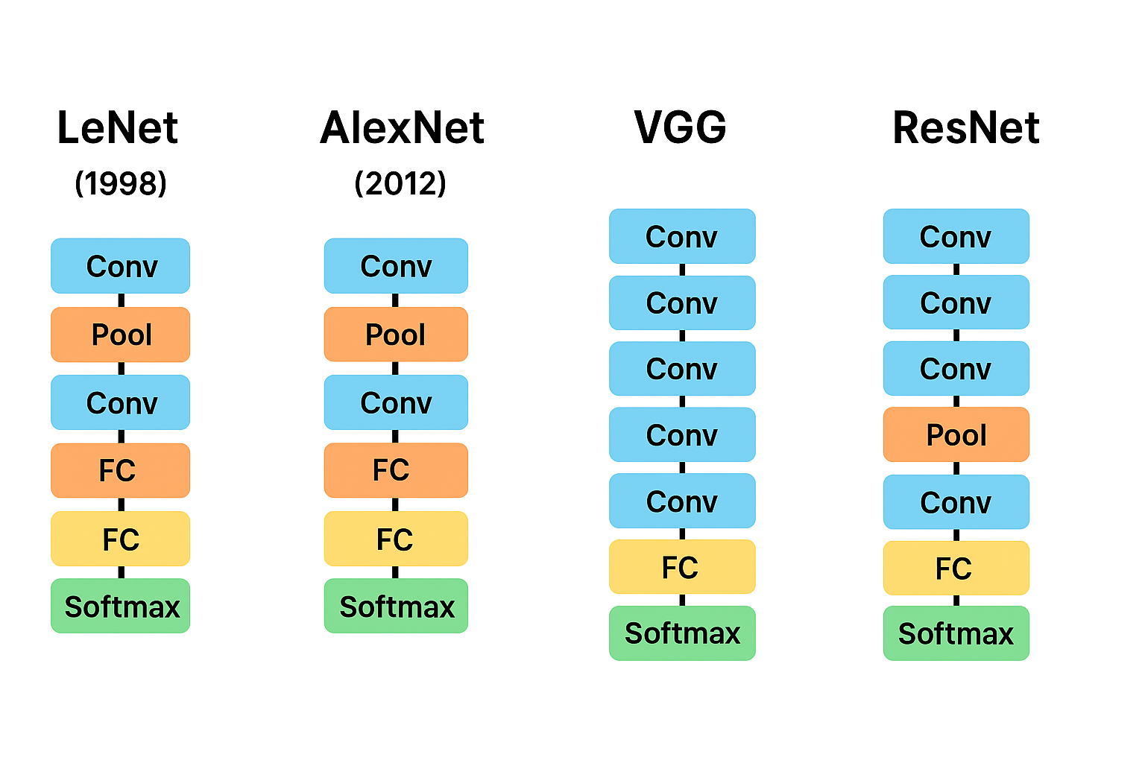
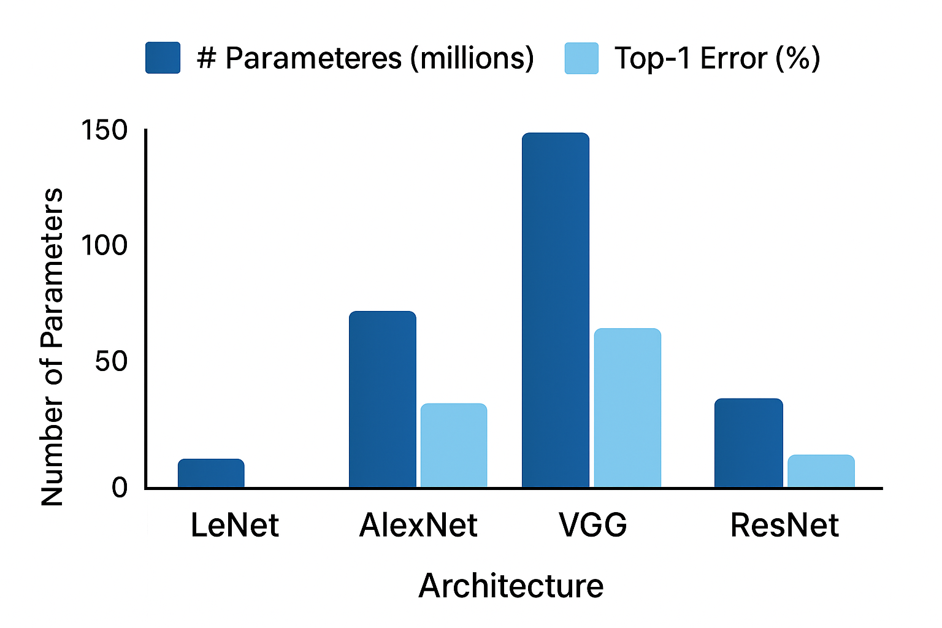

Slide 5
Each model’s input size differs (32×32 for LeNet, 227×227 for AlexNet, 224×224 for VGG/ResNet)
Model Parameters Accuracy (%) Train Time (s)
LeNet 61,706 68.50 25.4
AlexNet 3,154,442 72.12 61.8
VGG16 14,714,634 77.85 120.3
ResNet50 23,587,712 84.56 180.9

Slide 6
Questions
1. Why doesn’t adding layers always help? Deep networks degrade w/o skip connections
2. What if we unfreeze all ResNet layers? Overfits small data
3. How do skip connections help? Skip connections preserve gradient flow
4. Would AlexNet improve with BatchNorm? BN stabilizes & regularizes
5. When might transfer learning fail? Fails with domain mismatch

Slide 7
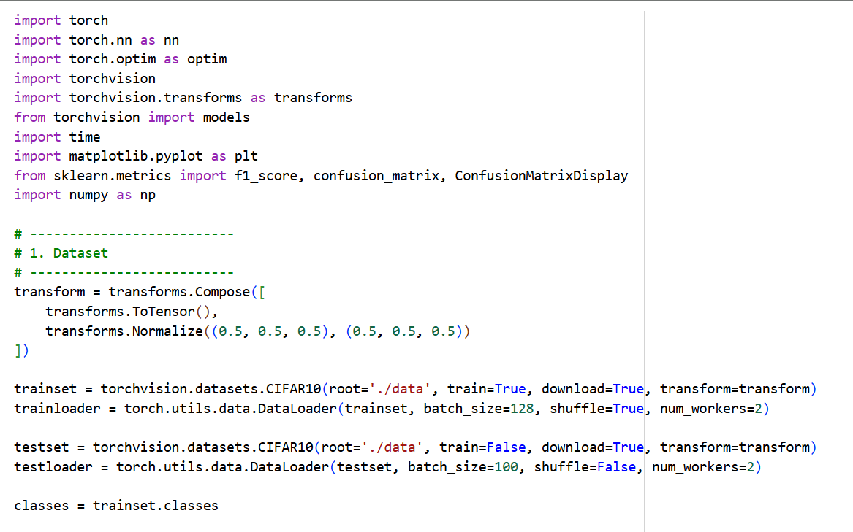

Slide 8
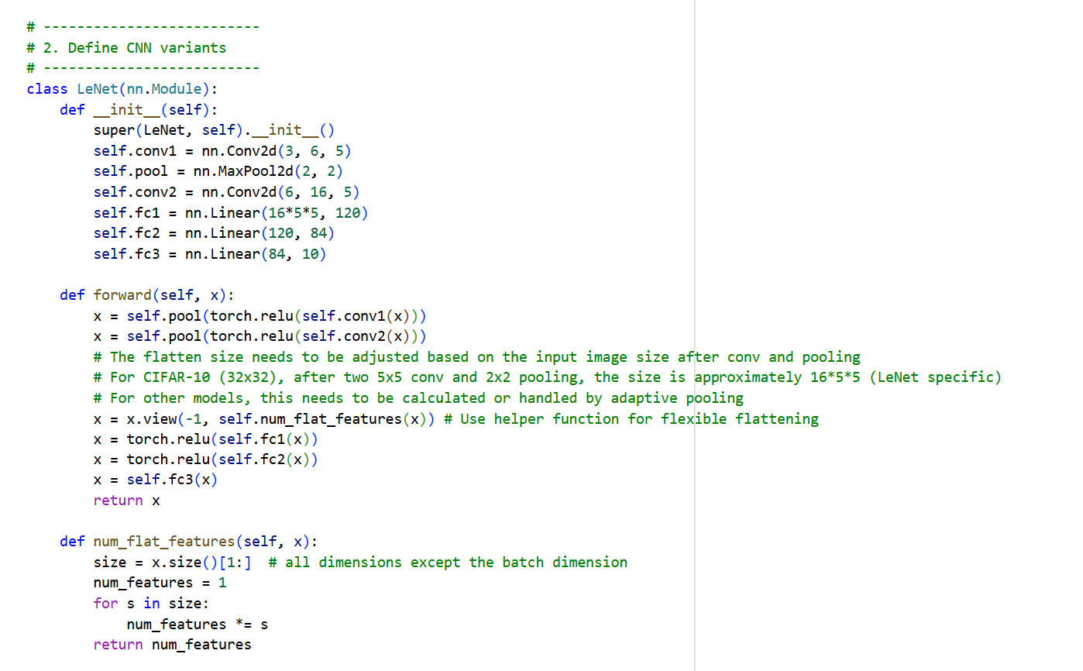

Slide 9
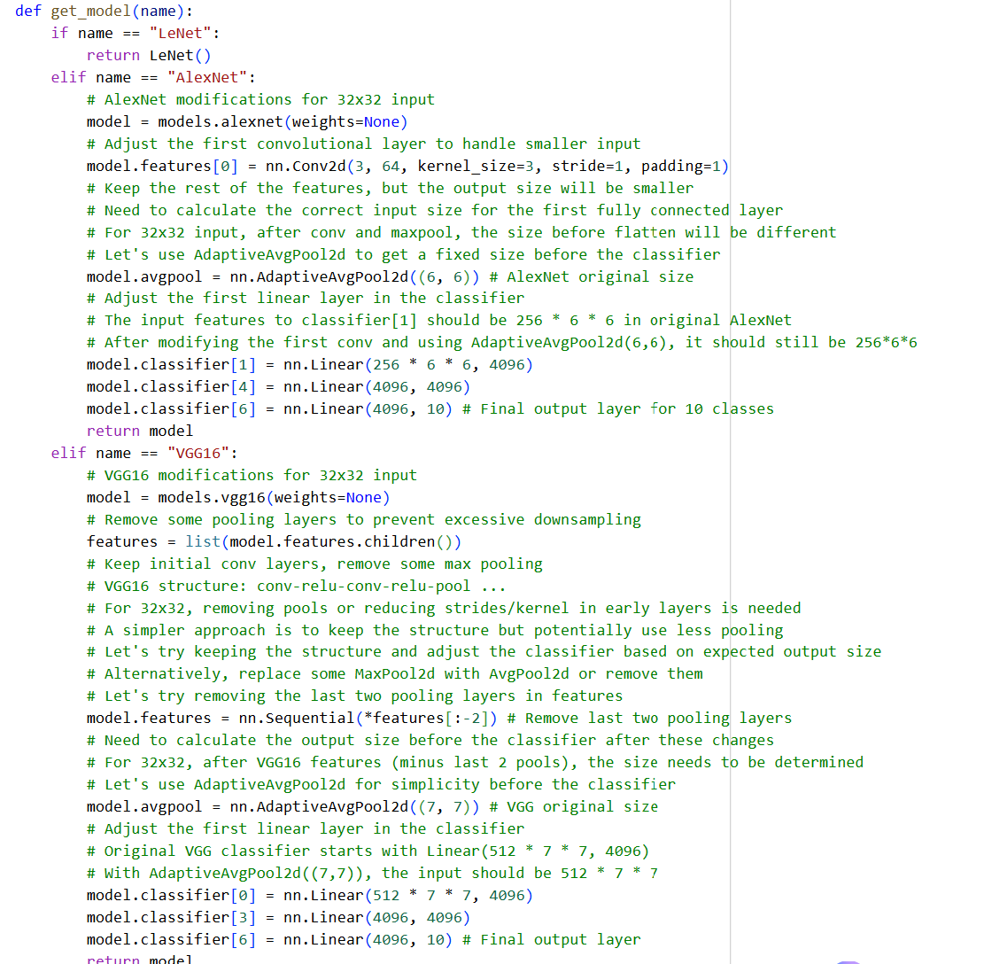

Slide 10
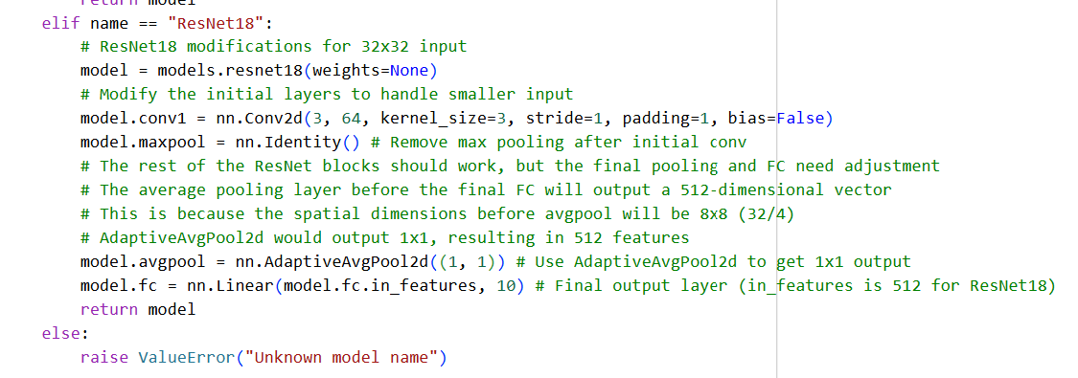

Slide 11
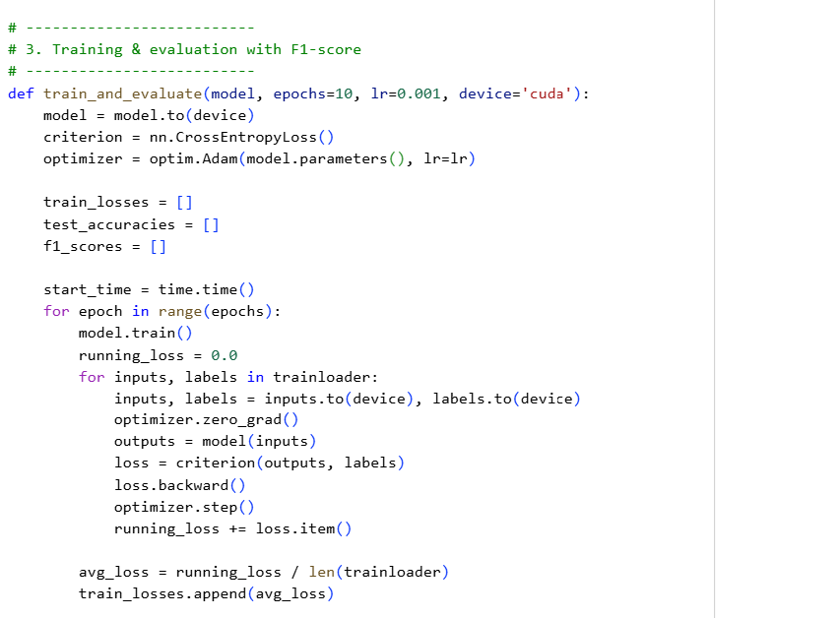

Slide 12
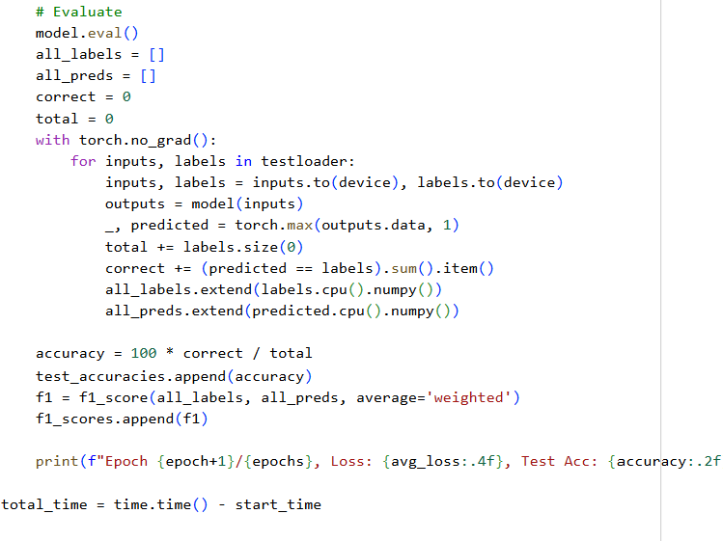

Slide 13
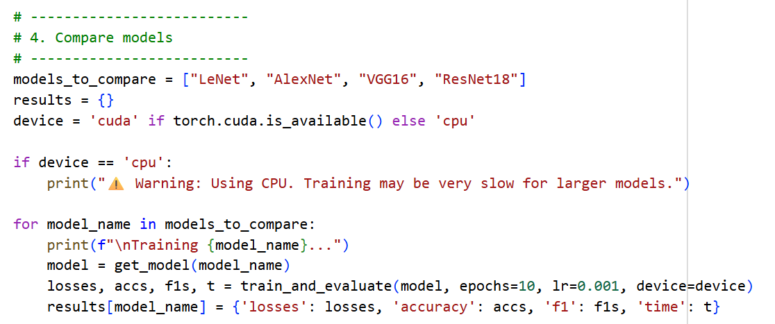

Slide 14
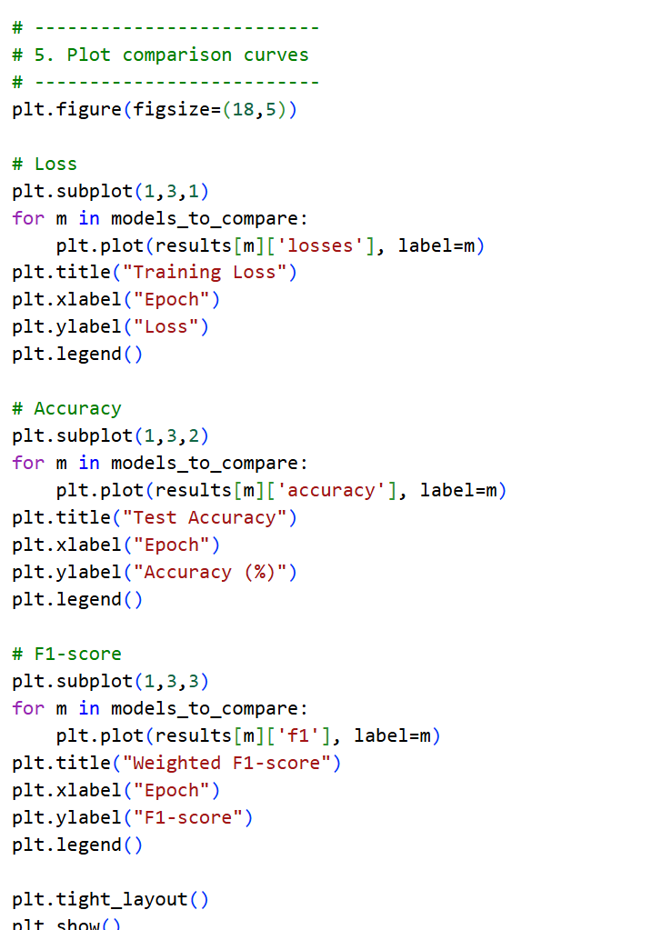

Slide 15
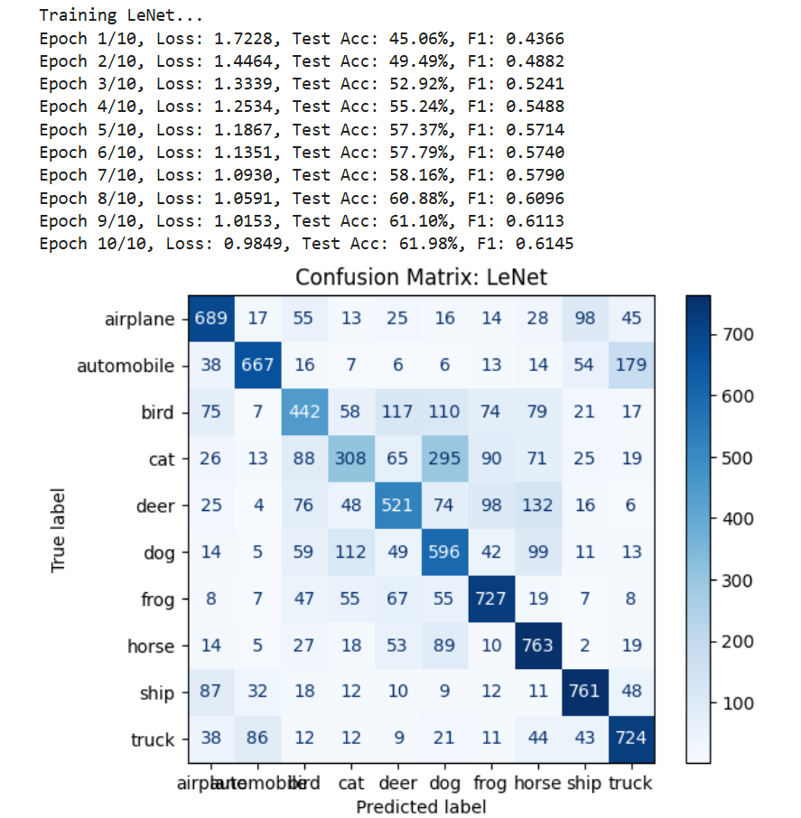

Slide 16
